Slide 1


EDA Project on Heart Attack Analysis
Sunnapuralla Bhargavi

Slide 2
About Me: I am pursuing 3rd year B.Tech in branch of Artificial Intelligence and Data Science in Aditya college of Engineering ,Madanapalli. I’m working as a Data science intern at Internx.
Experience: I am currently doing my internship on Data Analysis and Machine learning , gaining valuable hands-on experience and insights into real-world applications of these technologies.
http://www.linkedin.com/in/bhargavi-s-20120b2a1
https://github.com/SunnapurallaBhargavi

Slide 3
Agenda
Objective
Data Description
Data Cleaning
Data Analysis
Uni variant Analysis
Bi variant Analysis
conclusion

Slide 4
Objective:
Develop analyze and predict the presence or absence of heart disease based on various risk factors and clinical measurements.
The primary goal is to build accurate and reliable models that can assist in early detection and diagnosis of heart disease.
Determine the importance of different features or variables in predicting heart disease.

Slide 5
Data Description
age - Age of the person.
gender - Gender of the person.
0:Male
1:Female
Chest Pain - Chest Pain type:
Value 1:typical angina
Value 2: atypical angina
Value 3: non-angina pain
Value 4: asymptomatic
trtbps - resting blood pressure (in mm Hg).
chol - cholestoral in mg/dl fetched via BMI sensor.
Blood sugar - (fasting blood sugar > 120 mg/dl) (1 = true; 0 = false).
restecg - resting electrocardiographic results.
Value 0: normal
Value 1: having ST-T wave abnormality (T wave inversions and/or ST elevation or depression of > 0.05 mV)
Value 2: showing probable or definite left ventricular hypertrophy by Estes' criteria
max_hr - maximum heart rate.

Slide 6
Data Description
exng - exercise induced angina (1 = yes; 0 = no).
old peak - Previous peak.
slp – Slope:
0:upsloping
1:flat
2:downsloping
num_vessels- number of major vessels (0-3).
thall - Thal rate:
0:normal 0
1:normal 1
2:fixed defect
3:reversable defect
output- Target variable:
0= less chance of heart attack
1= more chance of heart attack

Slide 7
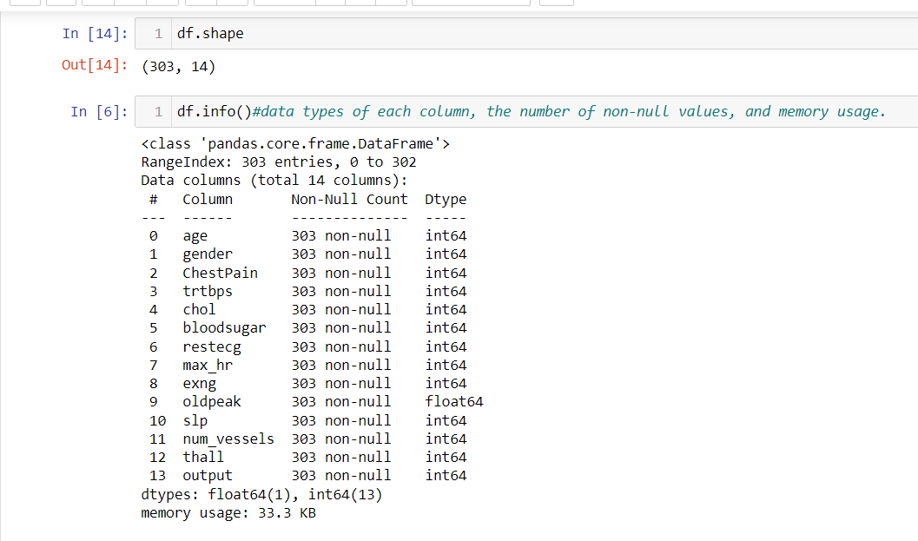
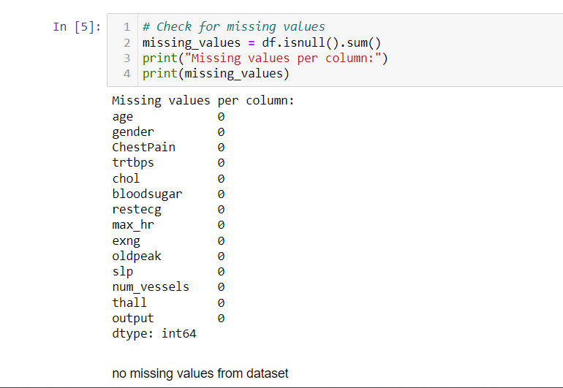
Data Cleaning
Data frame consists of 303 rows and 14 columns.
One row having duplicate values those are dropped .
No missing values in dataset.

Slide 8
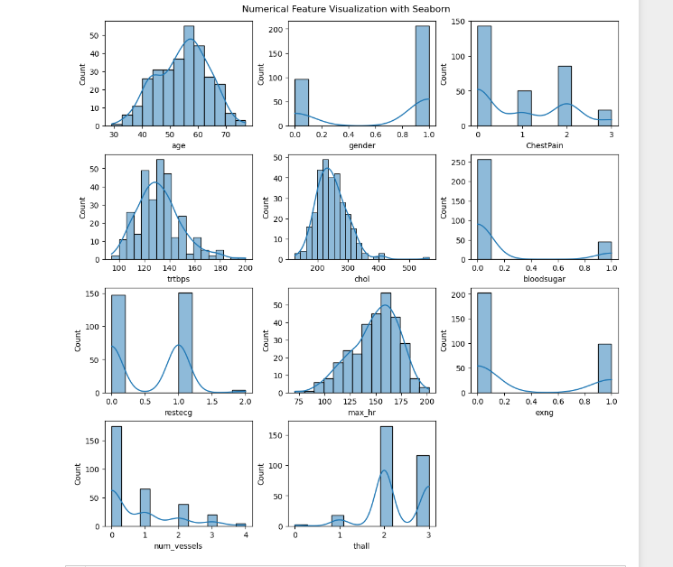
Data Analysis
Age variable is ranging max between 50-65.
Gender=1(females) has high heart risk.
Chest pain=0(typical angina) is experienced by most of people.
Trtbps is ranging between120 -150
Chol is spreaded around 200-350
More people has less than 120mg blood sugar(0=>120mg)
Ecg contributes same in many cases
Max_hr ranges between 130 -170
Exng =0 pain due to stress is minimum
Num_vessels are 0 in max people
Thall is not that related to heart failure

Slide 9
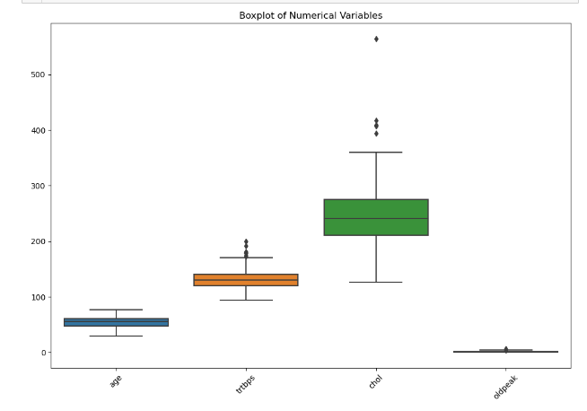
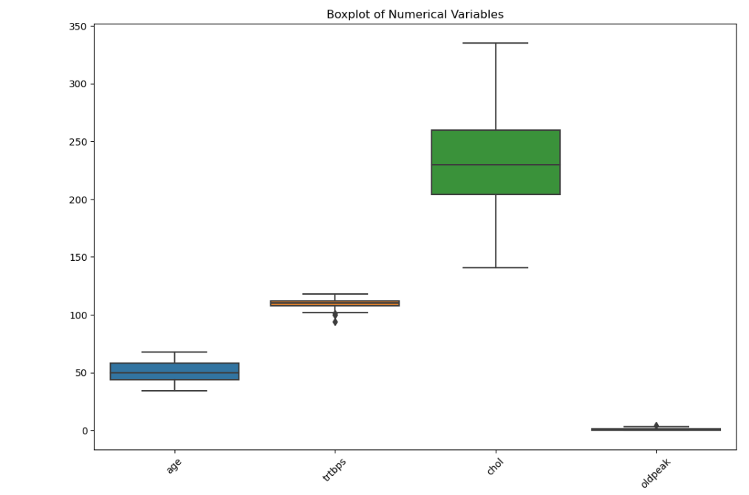
Uni variant analysis
Uni variant analysis on numerical variables of dataset.
Uni variant analysis is used to analyze single feature at a time.
I have interpreted numerical features using box plot.
In the initial figure we can see features like chol ,trtbps are having Some of the outliers.
Outliers are very small or very large values.
We have removed outliers in the next image.

Slide 10
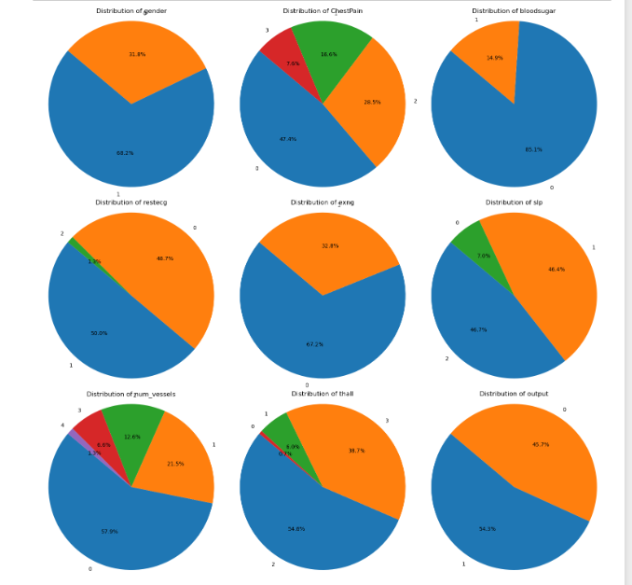
Uni variant analysis
Uni variant analysis on categorical features of dataset.
Uni variant analysis is used to analyze single feature at a time.
I have interpreted categorical features using pie plot.
Gender=1 has high heart risk.
Chest pain=0 is experienced by most of people.
More people has less than 120mg blood sugar(0=>120mg)
Ecg =1(abnormal ecg) contributes more in many cases
Slp =2 :down sloping is more
Exng =0 pain due to stress is minimum
Num_vessels are 0 in max people
Thall =2

Slide 11
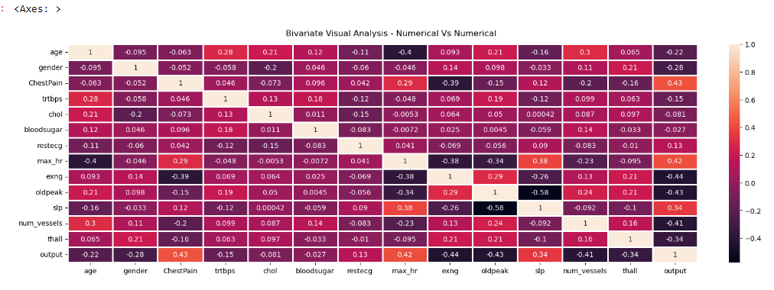
Bi variate correlation matrix heat map
positive values are directly proportional to target .
Chest pain , max_hr, slp are having strong correlation with output .
Restecg is mediumly related to output.
negative values are inversely proportional to target.
exng,oldpeak,num_vessels,thall are negatively related to output.

Slide 12
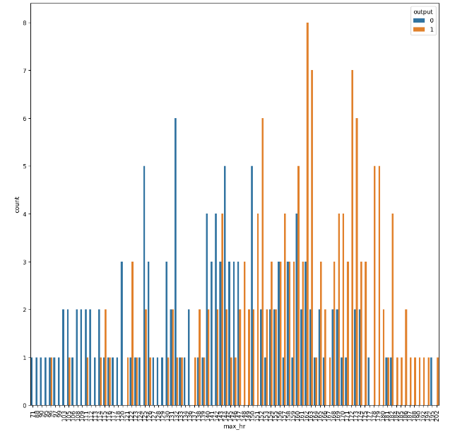
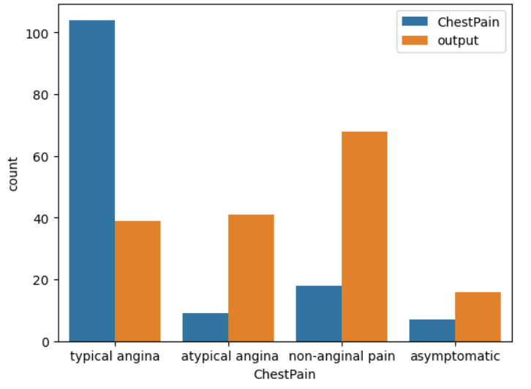
Variables related to output
Chest Pain (typical angina) is experienced by many people i.e: 48 %.
We can see non –anginal pain causes higher heart failure risk compared to other chest pain type.
Max_hr is high from 150 beats to 170 beats.
150 beats per min are said to be normal .
Higher than that can cause heart attack.

Slide 13
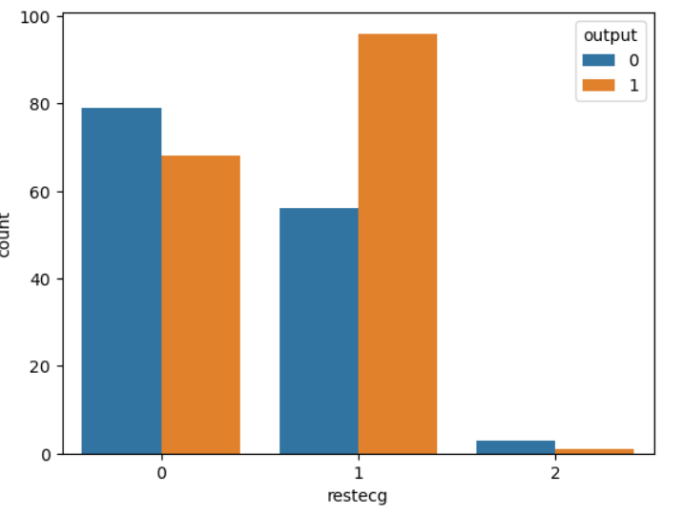
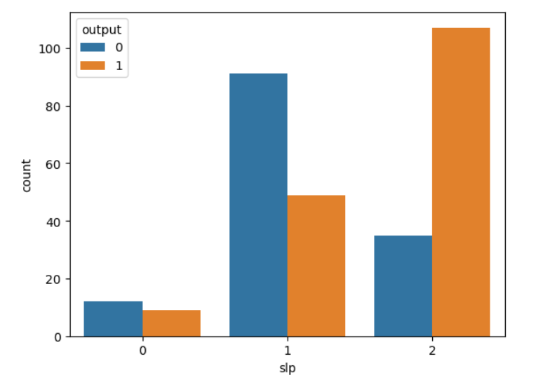
Variables related to output
Rest ecg variable shows most of the people ecgs are abnormal(1=abnormal).
Value 0: normal
Value 1: ST-T wave abnormality Value 2: definite left ventricular hypertrophy by Estes' criteri
Although normal ecg is possesed by 48% of people it causes less heart failure risk.
Slope 0:upsloping
1:flat
2:downsloping
Downsloping can cause high heart risk
Although 46% of people has slope flat , it causes low heart failure risk.

Slide 14
Conclusion:
The data consists of more females than twice the number of males.
People with Non-Anginal chest pain, have higher chances of heart attack.
People with 0 major vessels, have high chance of heart attack.
Females have higher chance of heart attack.
People with down sloping have much higher chance of heart attack.
People with no exercise induced angina, have higher chance of heart attack.
People with max_hr greater than 150 has high risk of heart failure.
People with abnormal ecg has high risk of heart failure.
The attributes like oldpeak,thall are less related to target variable

Slide 15

Thank you

